Slide 1


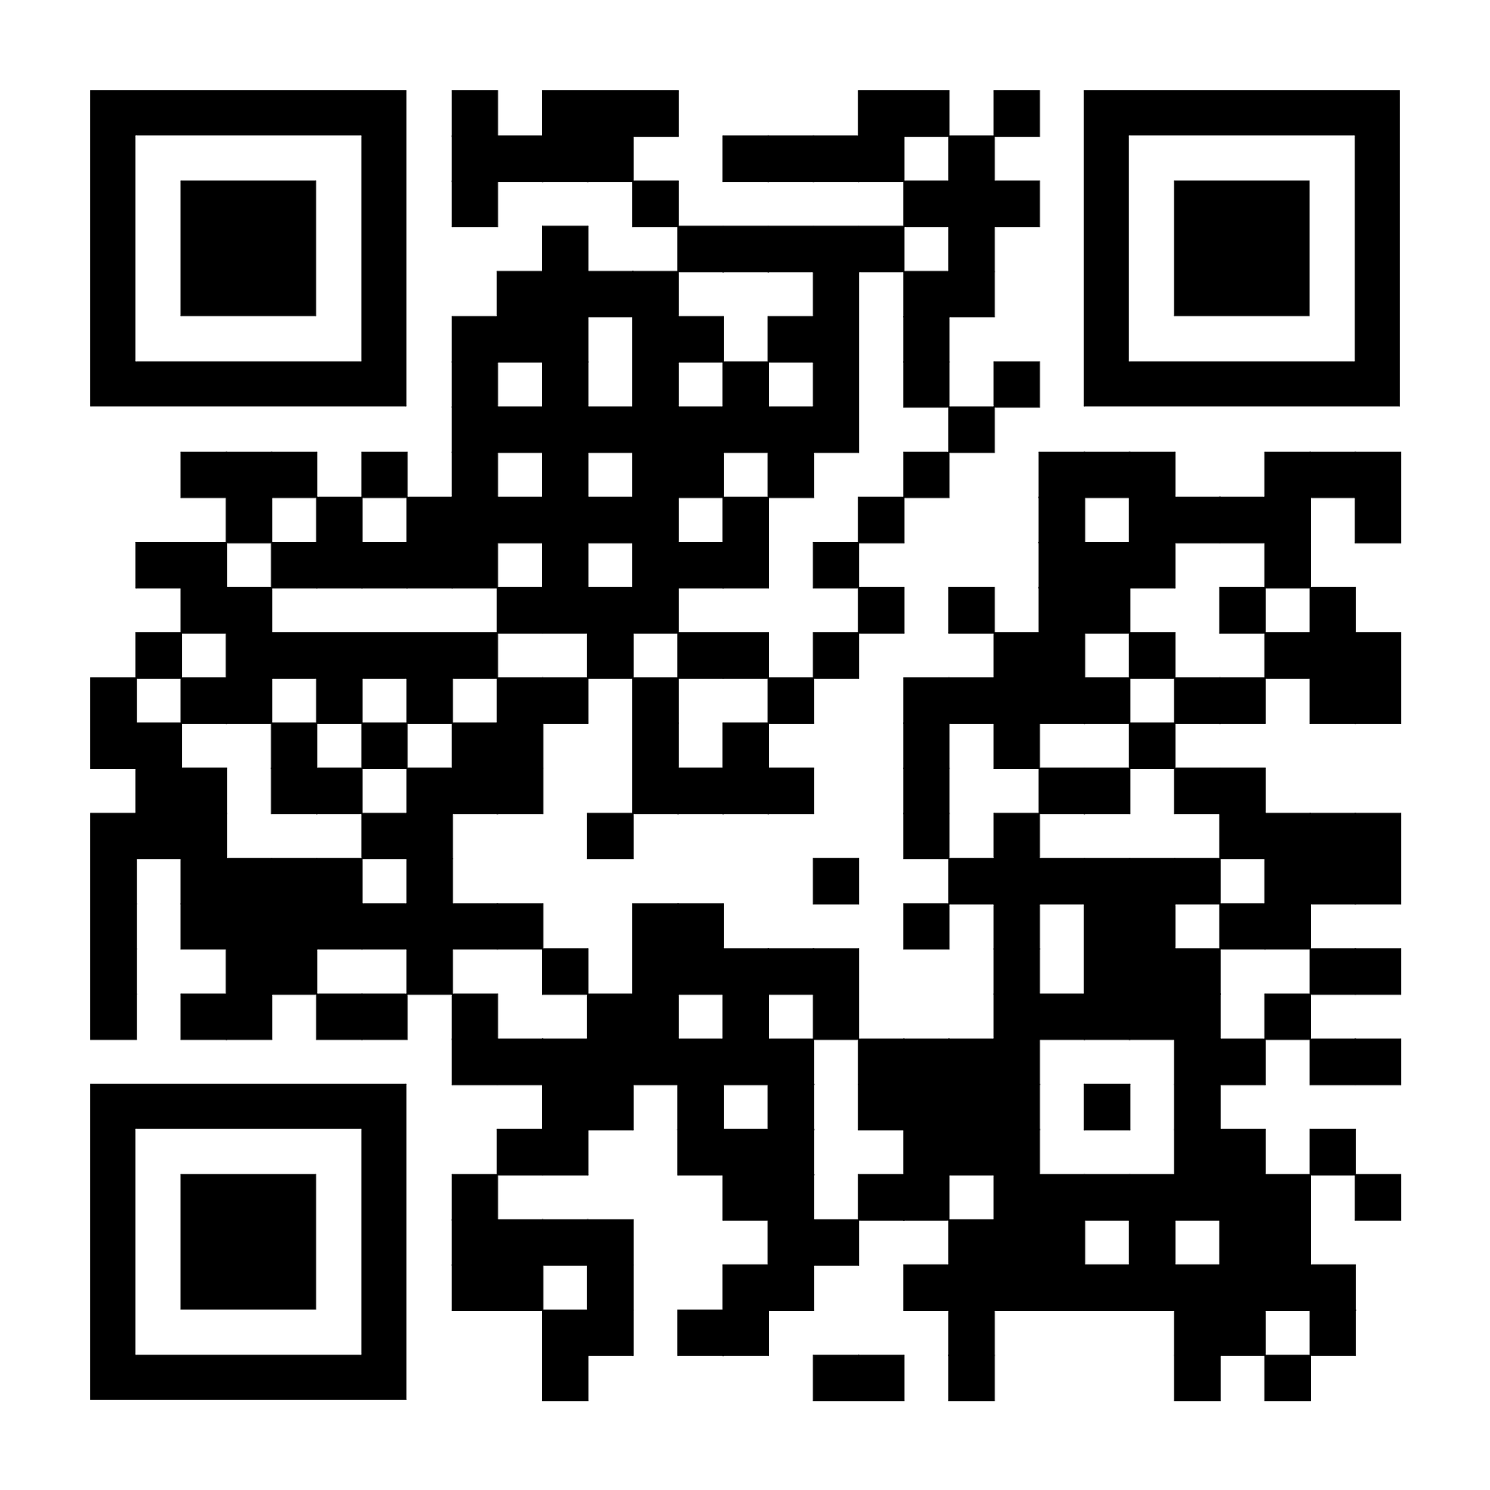
Minnesota National Guard Enlisted Association
(MNGEA)
Formed in 1970 as a non-profit professional organization
The only professional organization advocating specifically for MN Guard Enlisted Soldiers, Airmen and its retirees
Designed to protect the benefits Enlisted members & their families have while also advocating for future benefits and quality of life concerns of the Enlisted force.
MNGEA membership also includes membership in the National chapter, Enlisted Association of the National Guard of the Untied States (EANGUS)
Nonprofit arm of EANGUS, National Guard Relief Foundation
Membership Benefits
More members provide a stronger voice with National, State and Local Congressional Delegates (CODEL) when it comes to voting on legislative initiatives.
Ability to attend state and national conferences, professional development opportunities, mentorship, networking, exposure.
Access to National Guard Relief Foundation (grants and loans)
National, State and Chapter scholarship opportunities annually
Minuteman update, publication with latest updates and events effecting the National Guard
Dual-membership Status (EANGUS & MNGEA)
How to Become a Member
Visit MNGEA.com or Facebook
- $35.00 Annual auto renewal or annual
- $255.00 Lifetime membership
- Limited time offer for E1-E5, sign up for auto
renewal and get the first year free!
(Enter “E1-E5Only” in the discount code box)
MNGEA/EANGUS Legislative Accomplishments
VA home loans for NG members
No MN State Income Tax for Mil Pay (M-Day/AGR/DSG)
Montgomery GI Bill inception and expansions
TRICARE Reserve Select for Part-time Force
Post 9/11 GI Bill benefits
Transferable Education benefits to dependents
Retirement point increases
TSP inception and improvements
SCRA reemployment rights
Pre/Post-deployment TRICARE coverage
Mentel health access expanded to dependents
BAH and COLA increases
LOD medical coverage
MNGEA.com

